Slide 1

Create Orders Process Automation Activity
By: Benjamin Phillippy

Slide 2
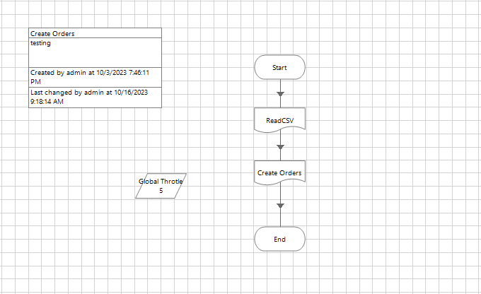
Main Page

Slide 3
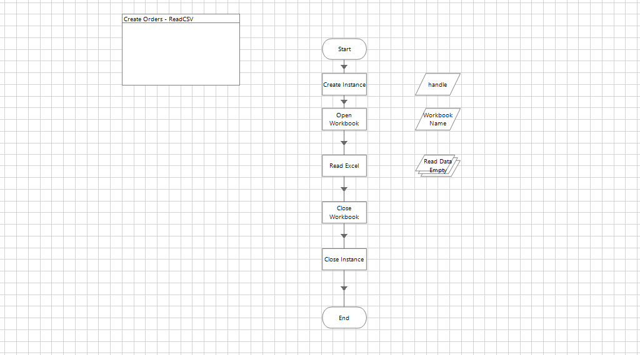
Read CSV

Slide 4
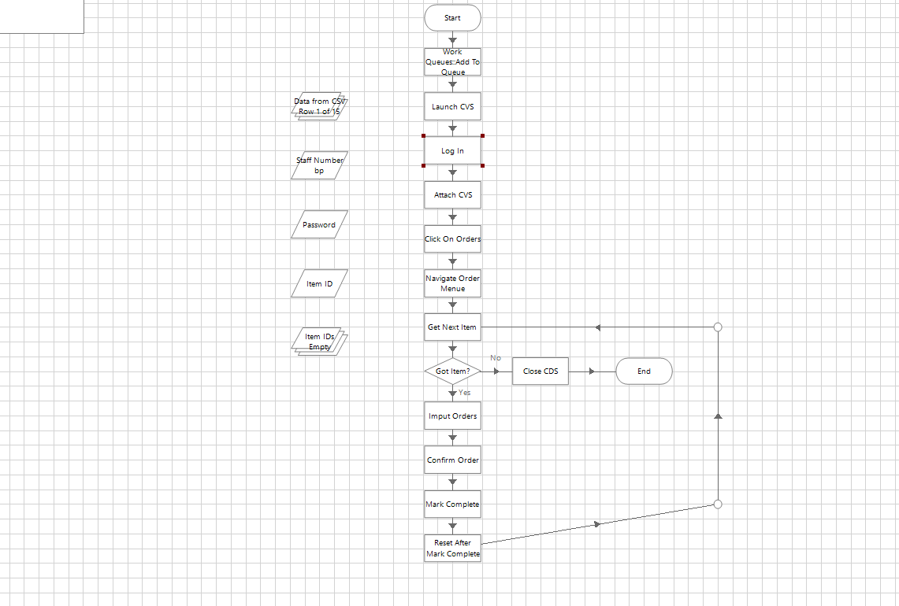
Create Orders

